Slide 1
Kit Contents
ENGR430 Computer Vision
Matthew Stein

Slide 2
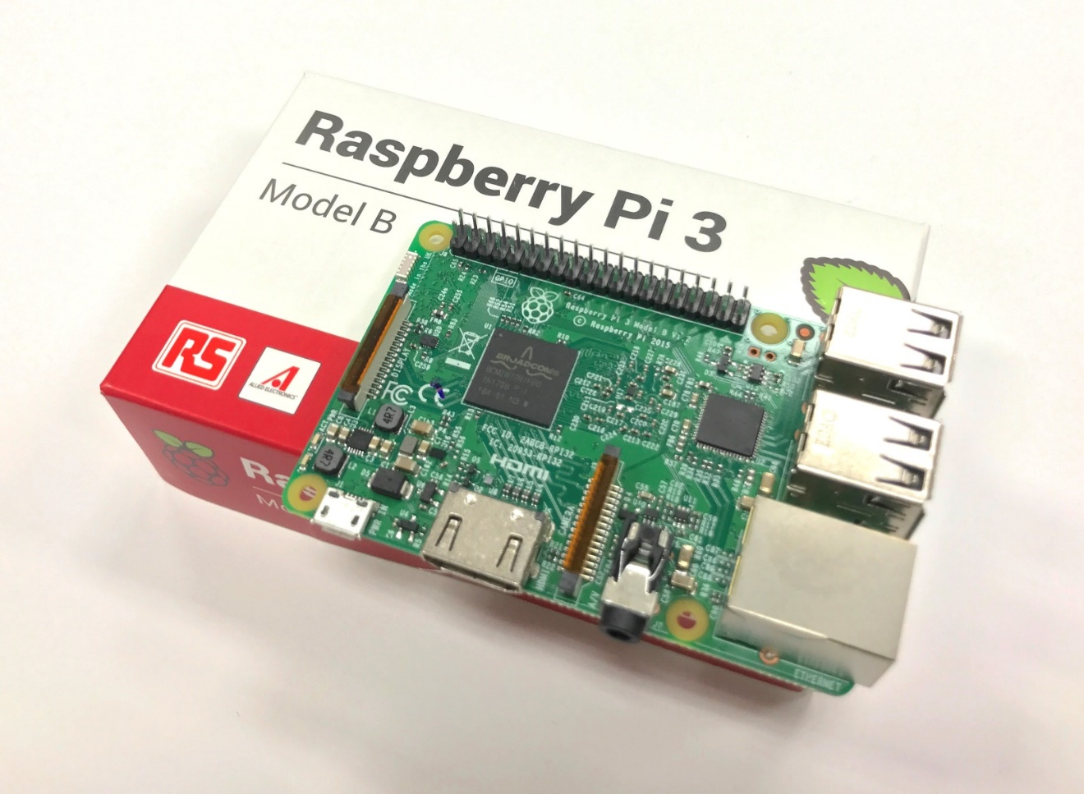
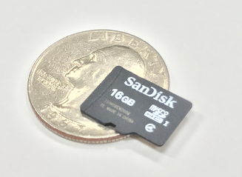
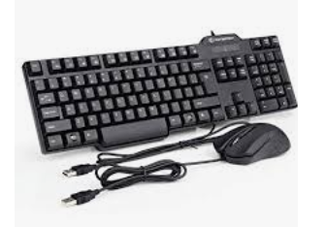

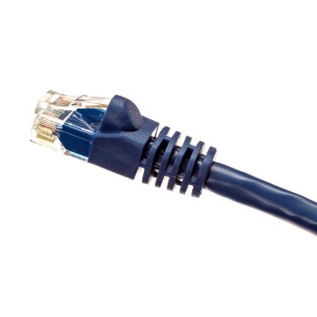
Raspberry Pi
Micro SD card contains operating system, drone software and OpenCV library
Without Monitor/Keyboard/Mouse it automatically establishes a WIFI network
Even a network jack
Any laptop can connect to network and remotely log in
Not included but very helpful:
HDMI Monitor
USB mouse and keyboard for direct operation as mini-computer
Once “boot up” everything is in place for immediate operation

Slide 3
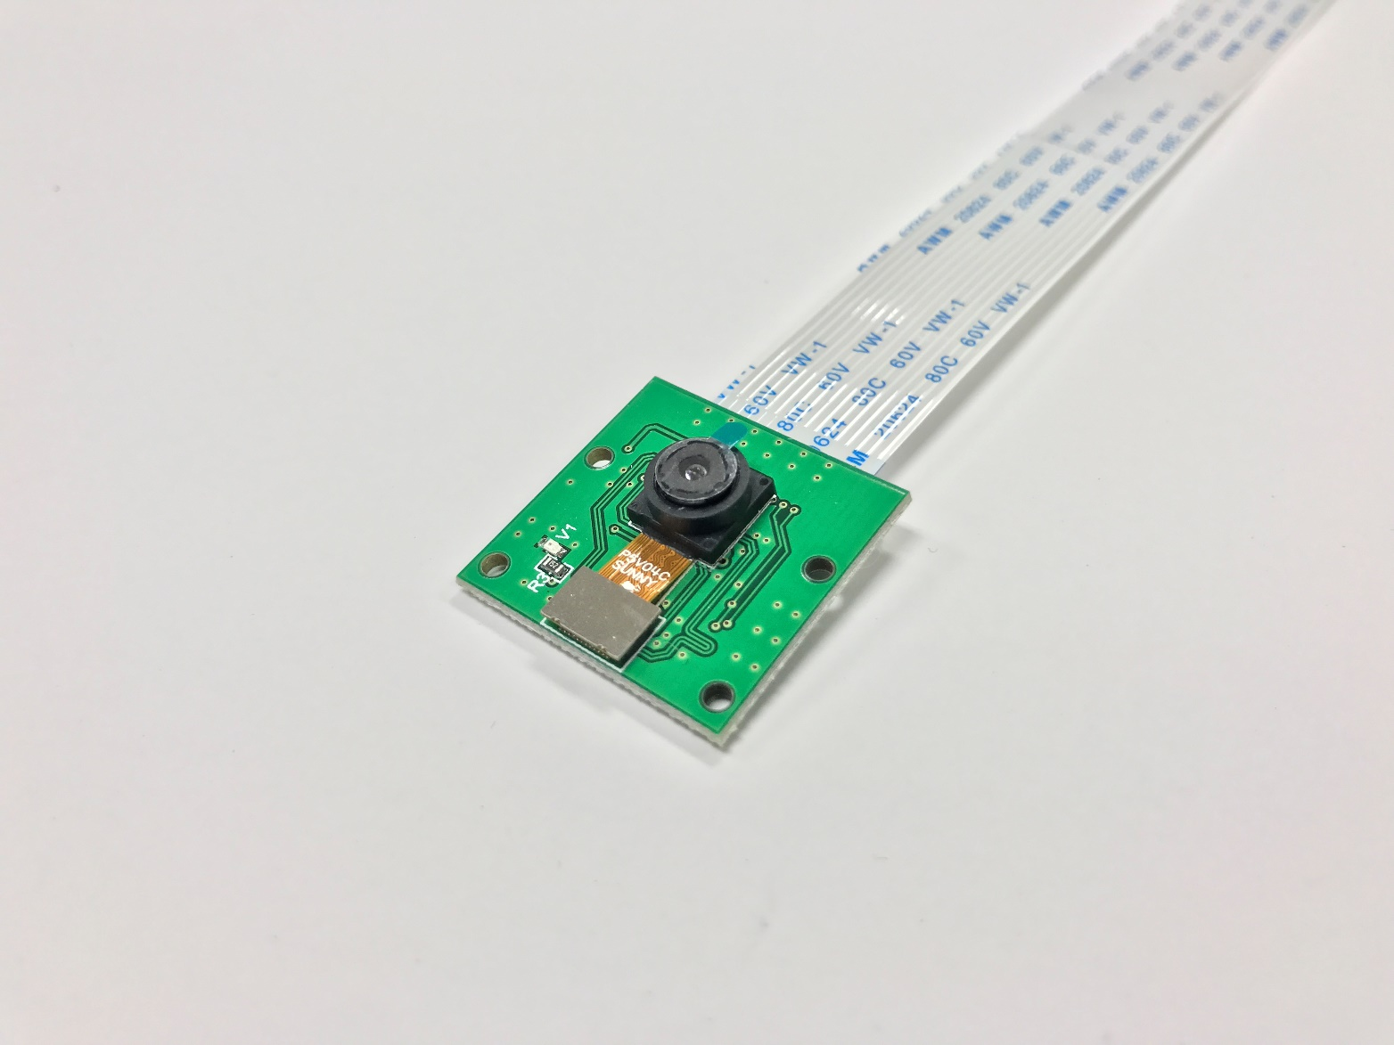
Raspberry Pi camera
Attaches at special purpose socket with ribbon connector
Assemble on drone within a few weeks
Works immediately

Slide 4
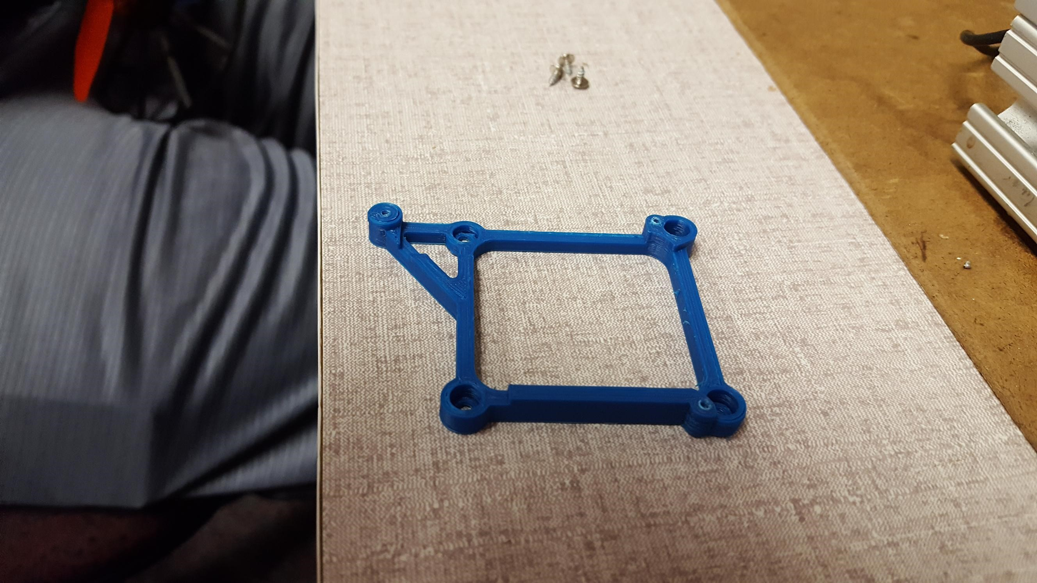
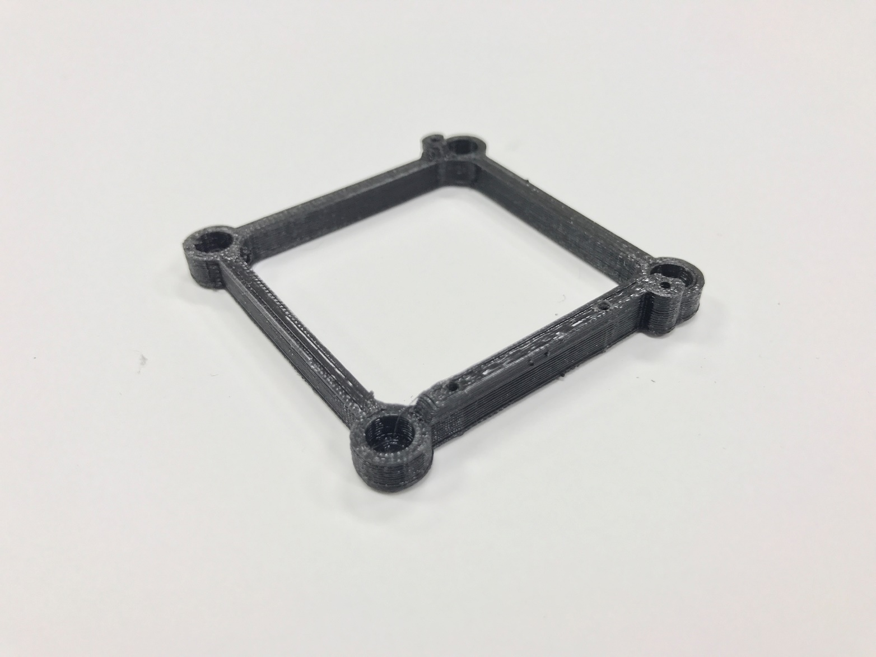
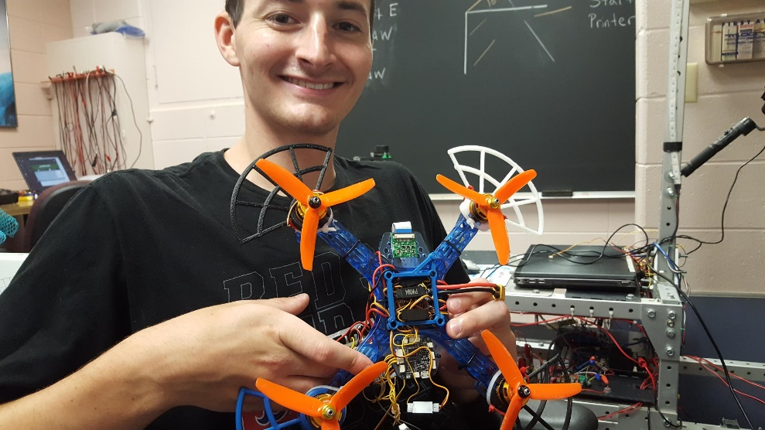
Pi Mount
Custom part
Was 3D Printed at Brown, but….
This summer Aidan Cafferty improved the design

Slide 5
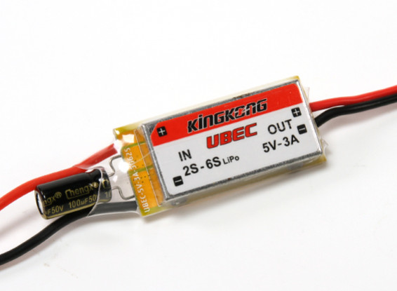
Battery Eliminator Circuit
“Eliminates” the need for separate motor batteries and electronics batteries
Converts 12V battery supply to 5V electronic supply

Slide 6
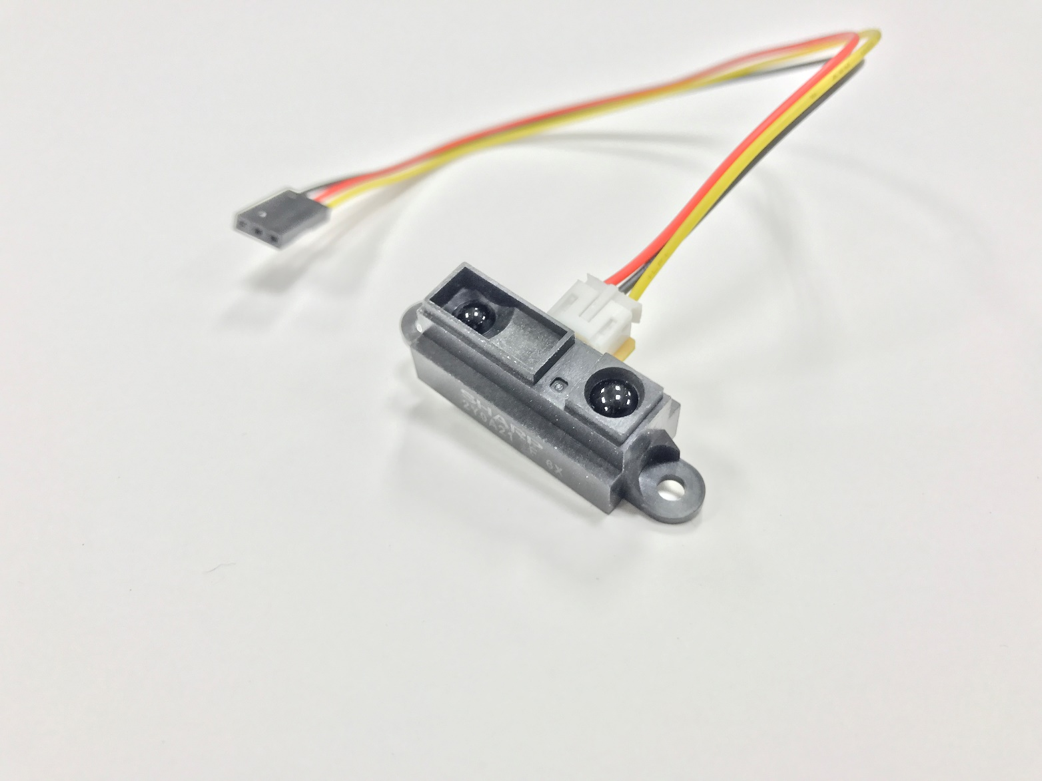
Range Finder
Infrared reflective sensor common in small mobile robots (i.e. Lego)
Returns a single analog voltage representing the distance to the first solid surface
Points downwards as independent altimeter

Slide 7
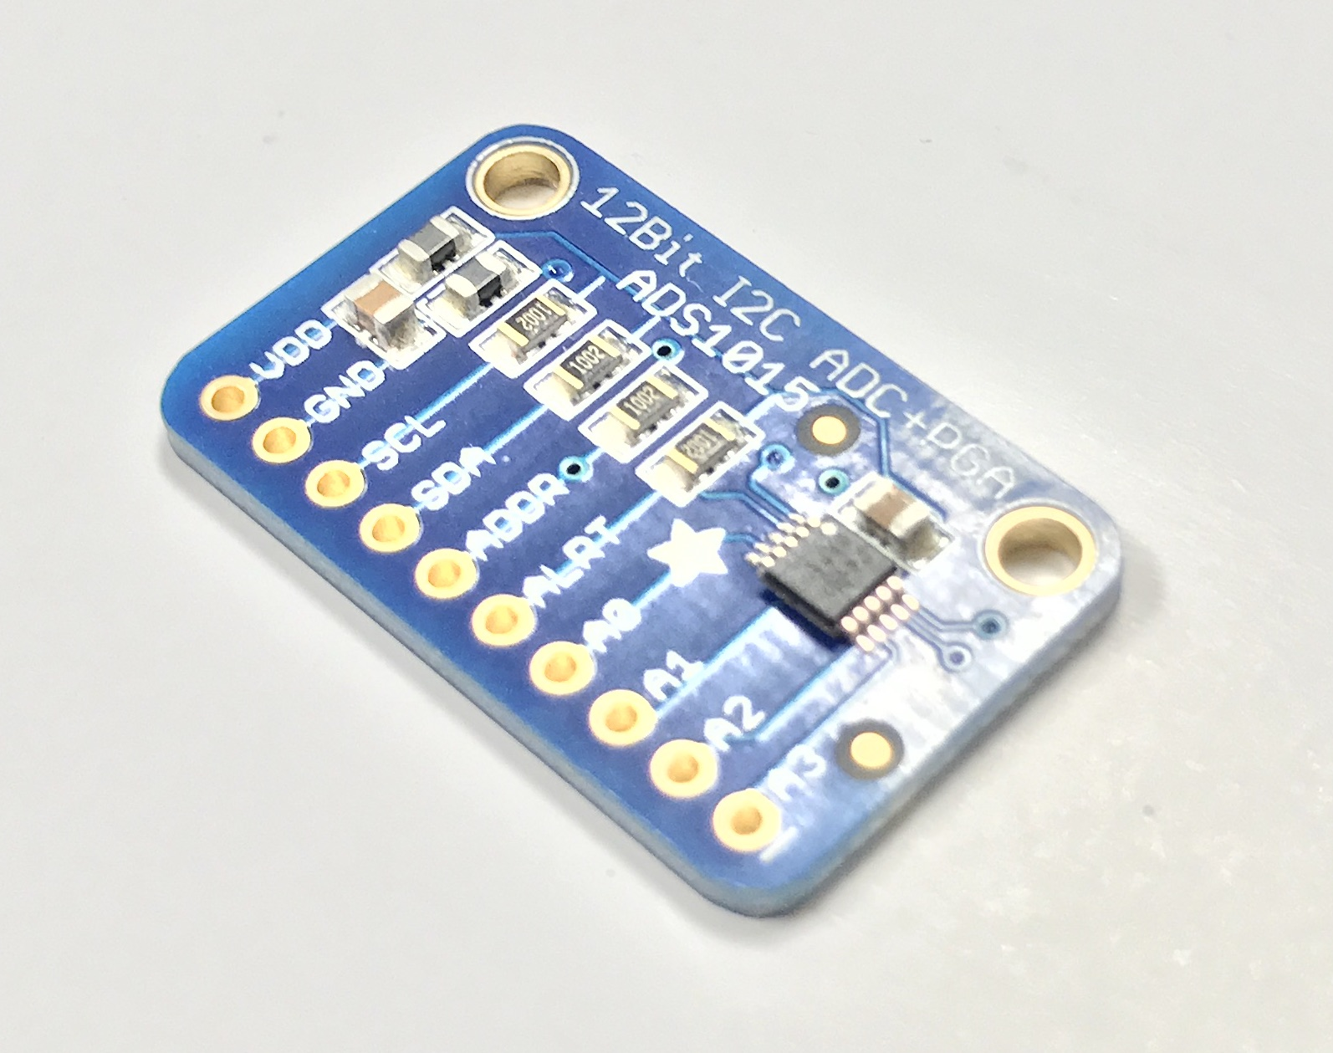
A/D converter
Dedicated to reading the IR range finder
Converts analog range signal to digital form readable by the Pi processor
Requires careful soldering

Slide 8
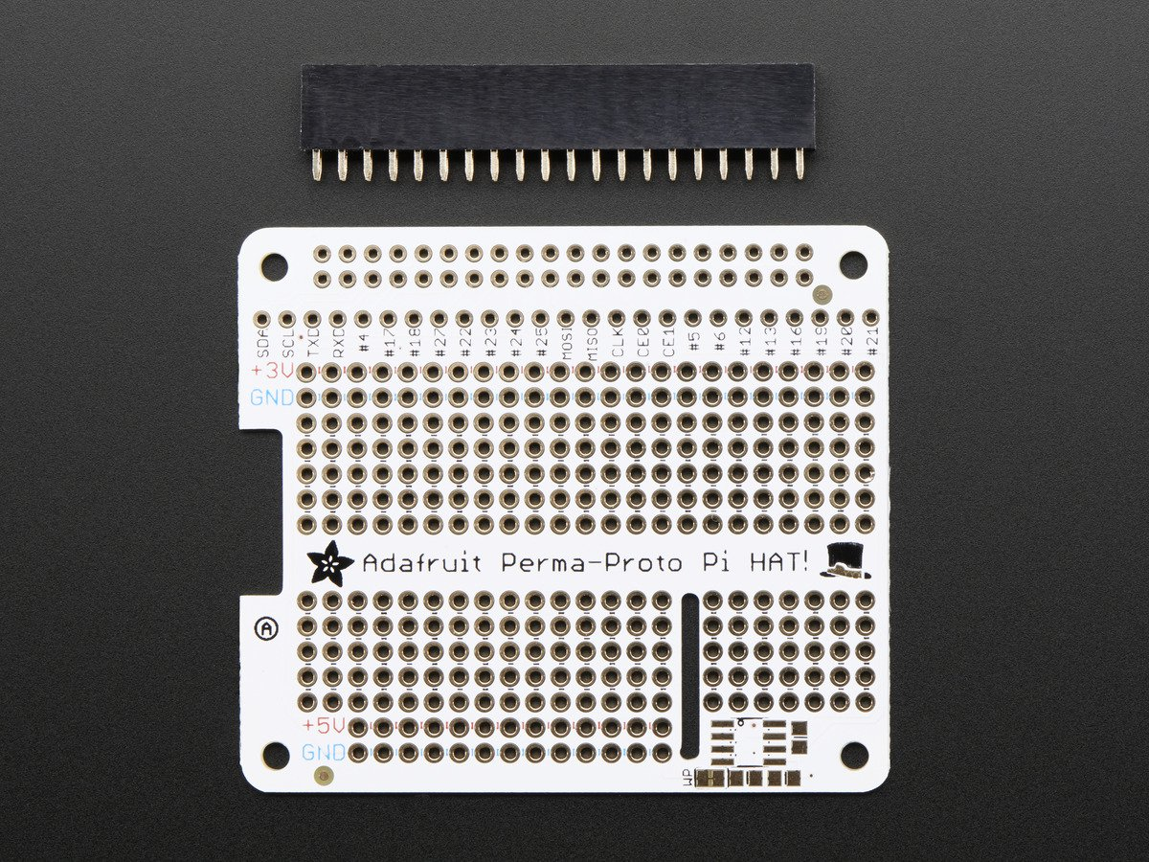
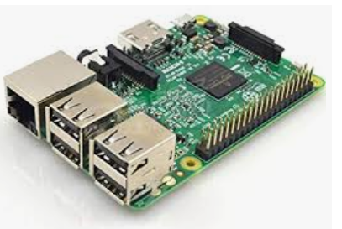
Pi “Hat”
Cute name
Sits on top of the Pi allowing convenient connection of external signals to its header pins
Virtually impossible to solder directly to header pins

Slide 9
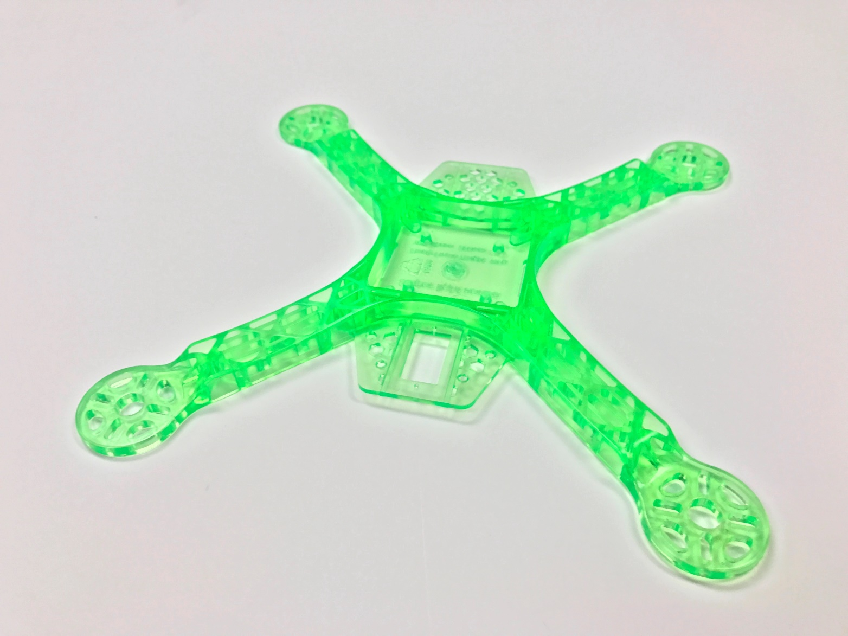
OTS Drone kit
Very low cost
Only use strong and lightweight frame
Some of the fasteners
Propellers do not have enough thrust to effectively lift
Also utilize legs, weakly attached

Slide 10
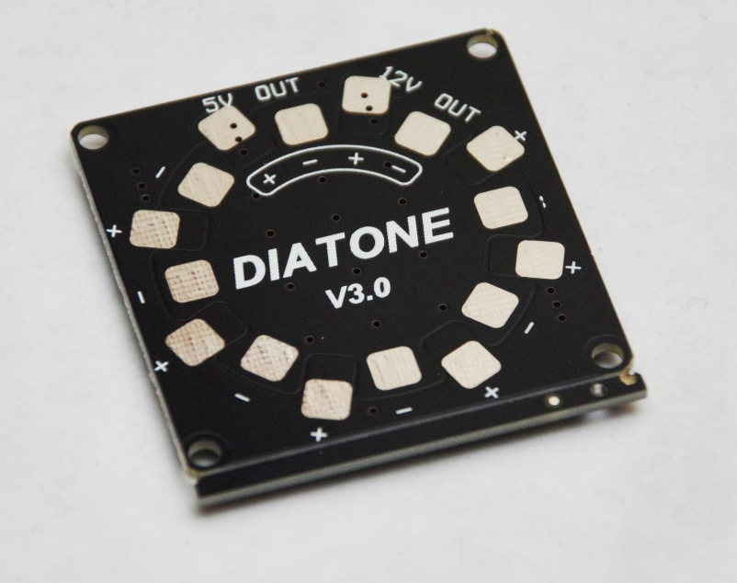
PDB
“Power Distribution Board”
Distributes main battery power to the 4 motor controllers
Also supplies power to Pi and range finder
High current

Slide 11
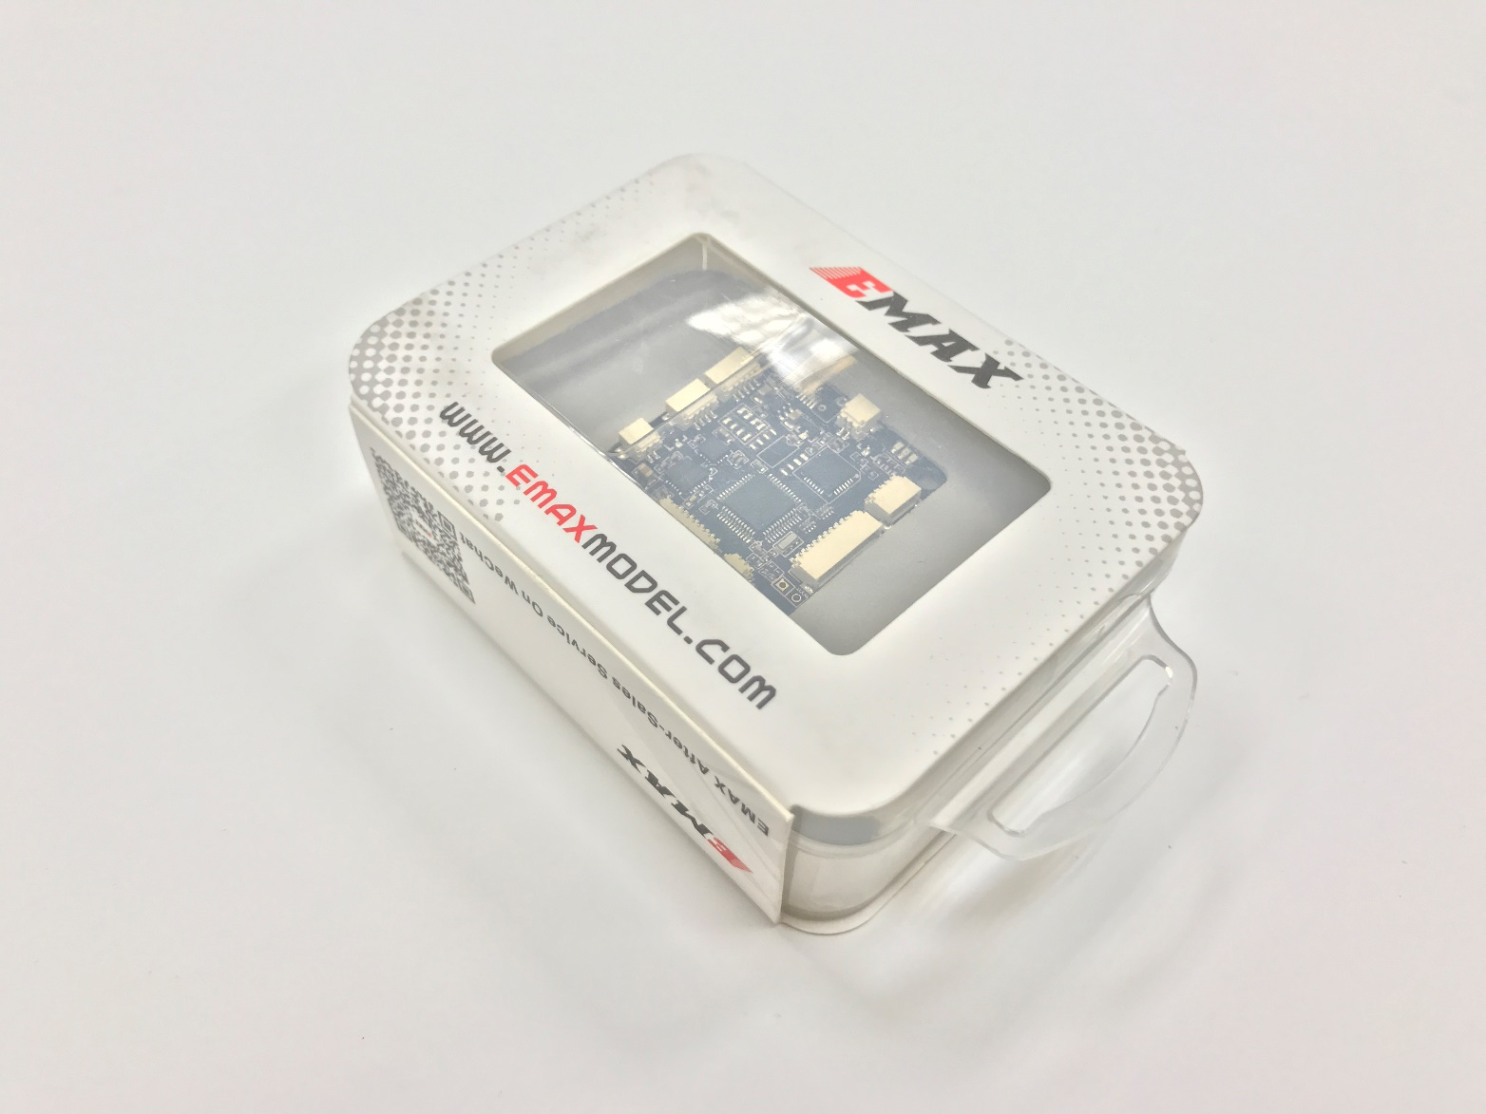
Flight controller
Special purpose flight control processor
Hardware processing for flight stabilization
Contains complete solution for quadcopter flight
Accelerometers and gyroscope
PWM motor control
Flash configurable
Requires calibration
Does not require PI

Slide 12
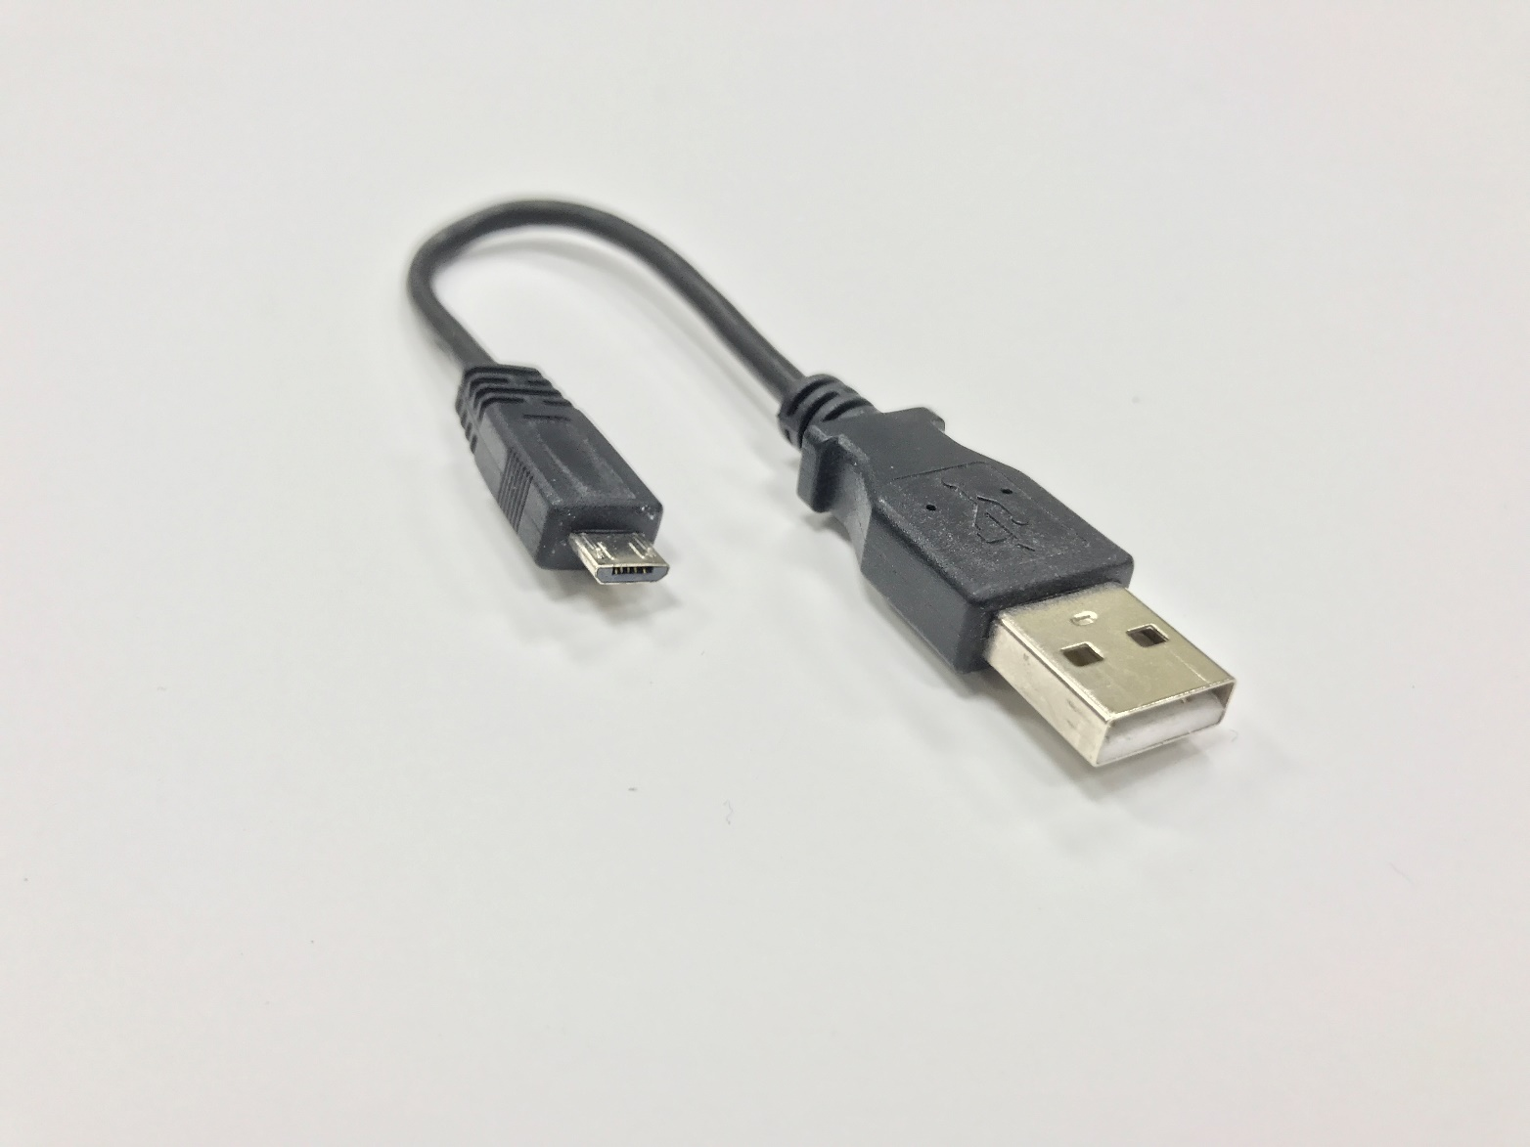
MicroUSB
Flight controller configures to accept commands from USB
Pi sends these commands with microUSB port

Slide 13
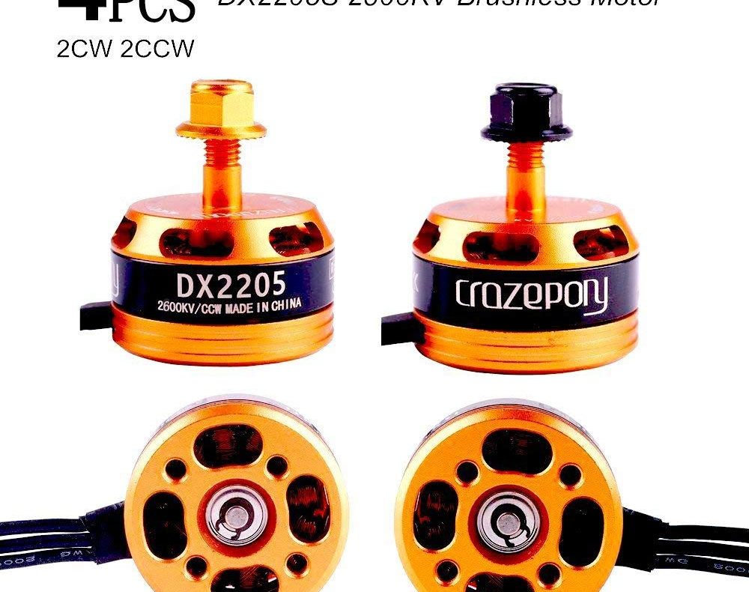
4 Motors
Very high power and light weight
Note cap color –
Two are CW and two are CCW motors
Fatal error to mix these up!

Slide 14
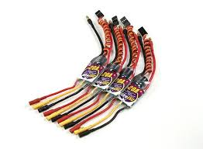
ESC
Electronic Speed Controller
Sophisticated controllers in tiny package
Flash configurable
Accept power and PWM control signals
Feed motor power to achieve commanded rotational velocity
Configured for CW or CCW

Slide 15
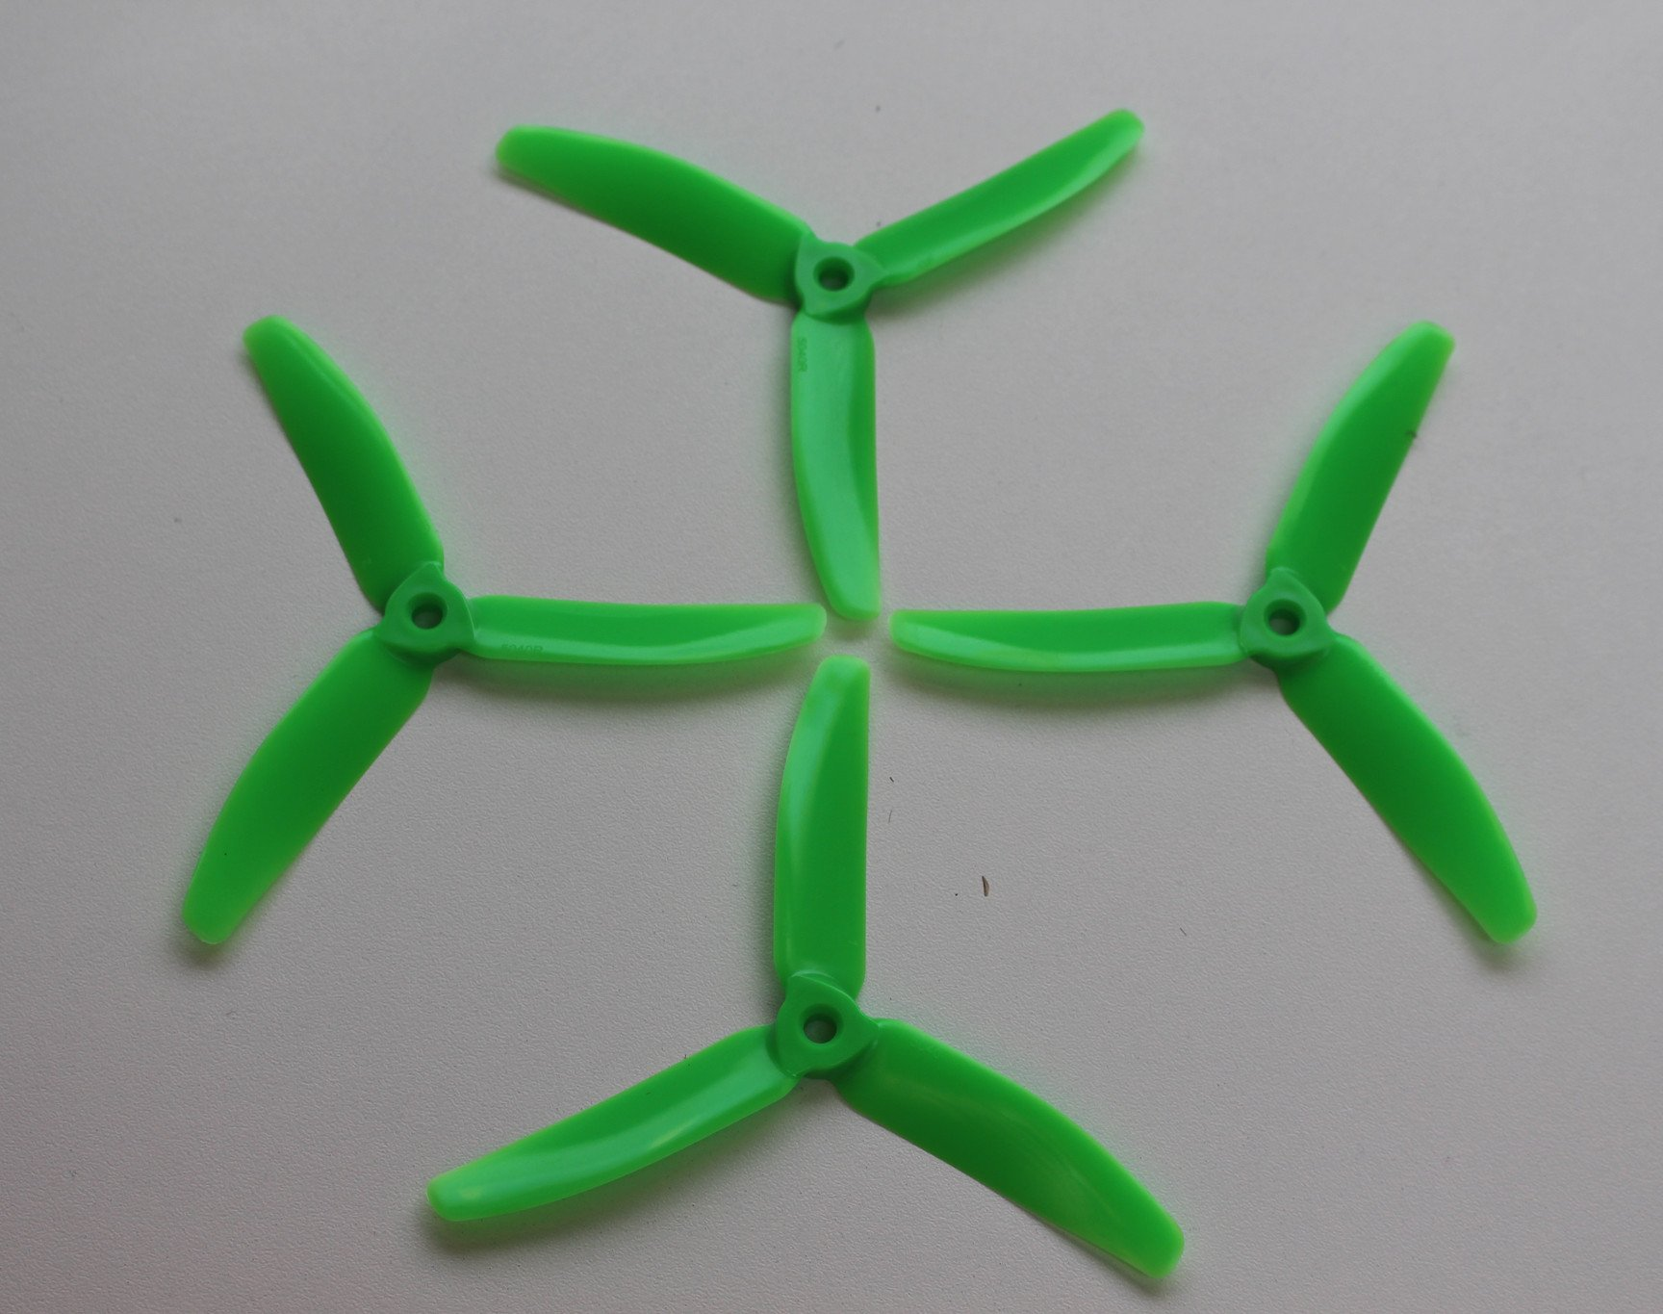
Propellers
3 blade for a little more thrust
Expense of drag, less efficient
Shorter flight time (2 min max starting from full battery)

Slide 16
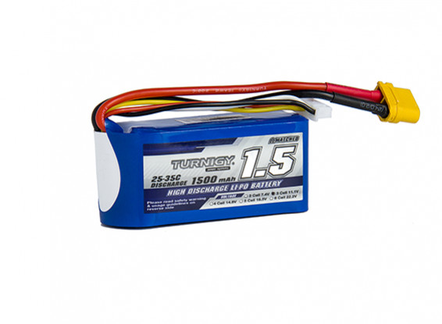
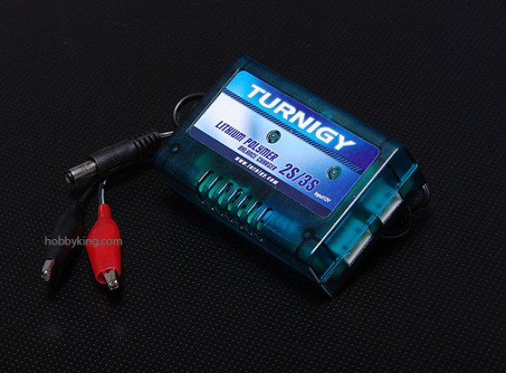
Battery & Charger
High performance for hobby applications
3 LiPo cells for about 12v
1.5 Amp hours
20-30A when fully discharging
30-minute charge, requires some planning care

Slide 17
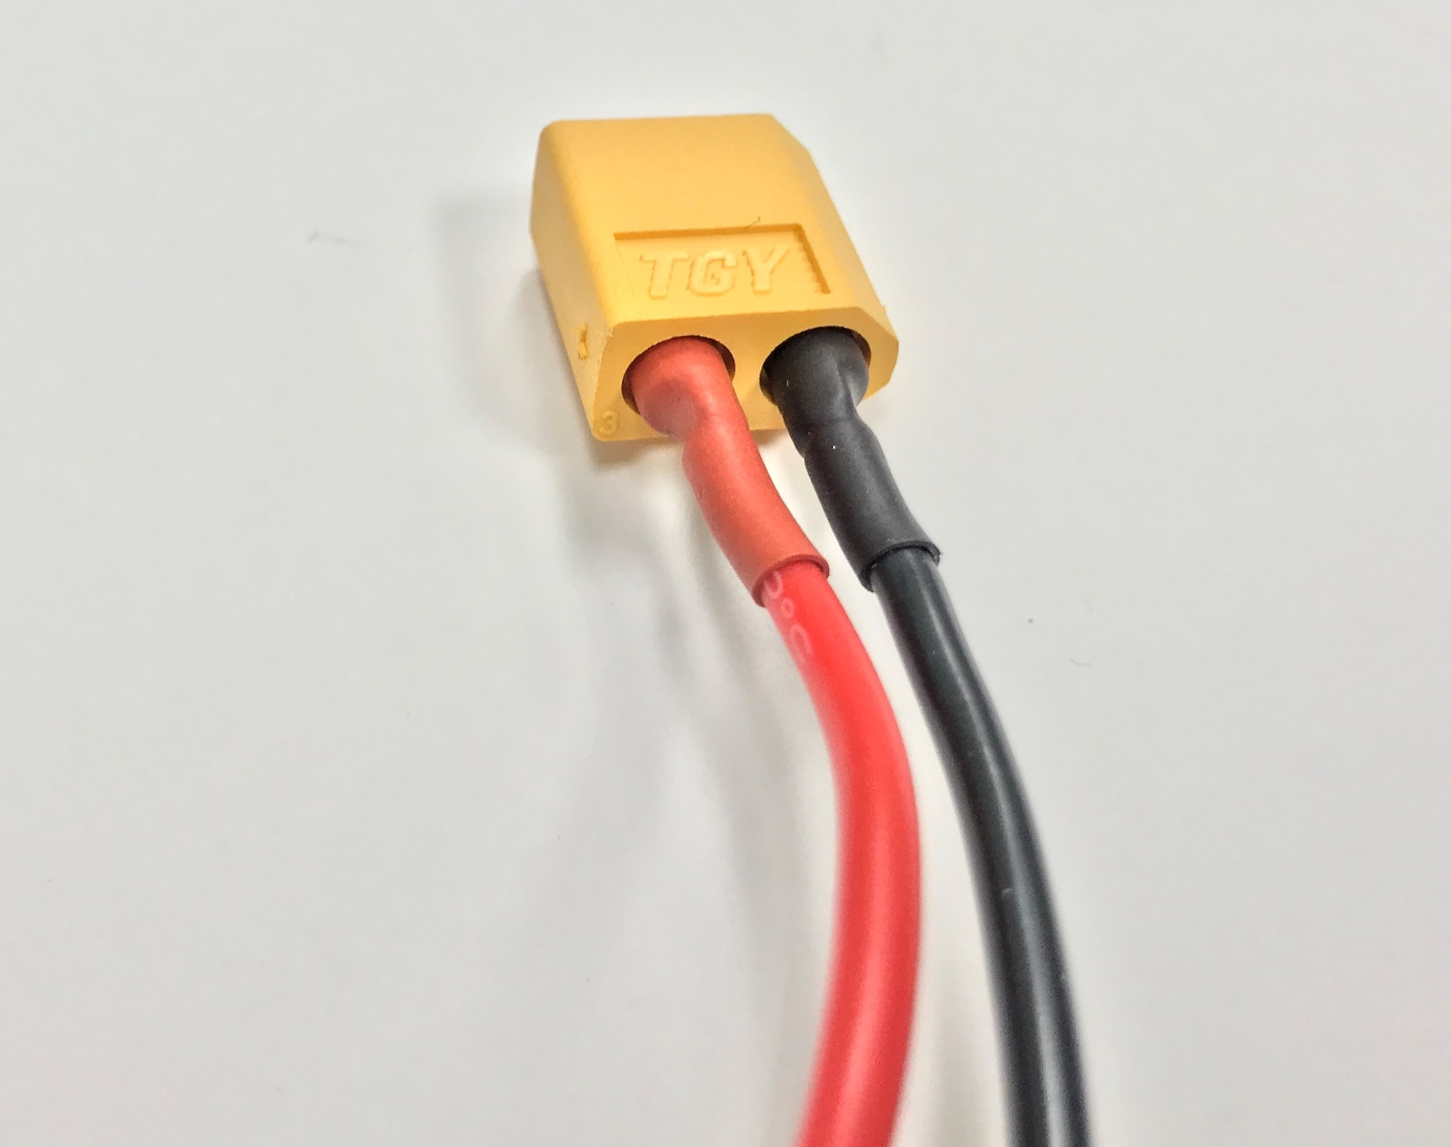
Pigtail connector
Connect battery to Power Distribution Board
Easy plug/unplug

Slide 18
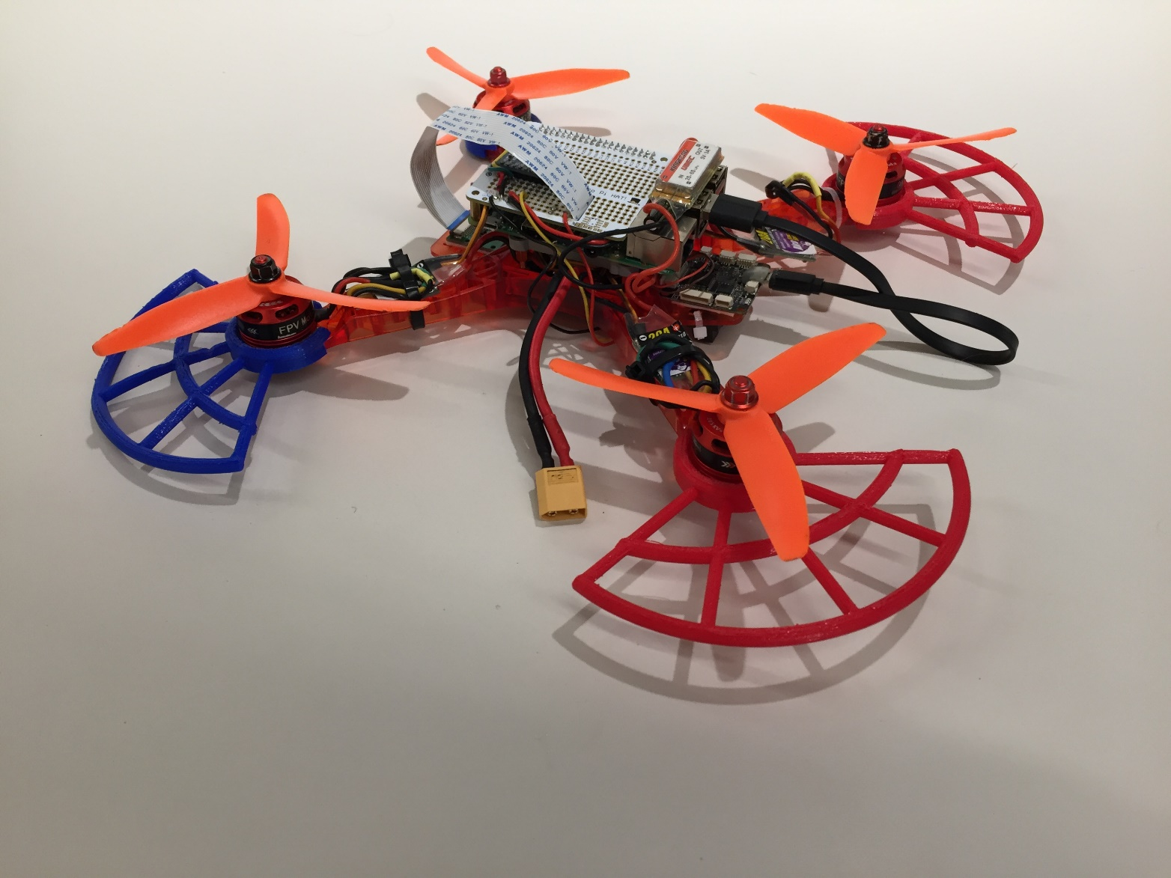
Propeller Guards
Three provided
Fourth you will 3D print (just for the experience of watching the process)
Very effective for bouncing off the sides of our flight test playpen

Slide 19
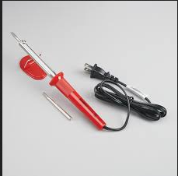
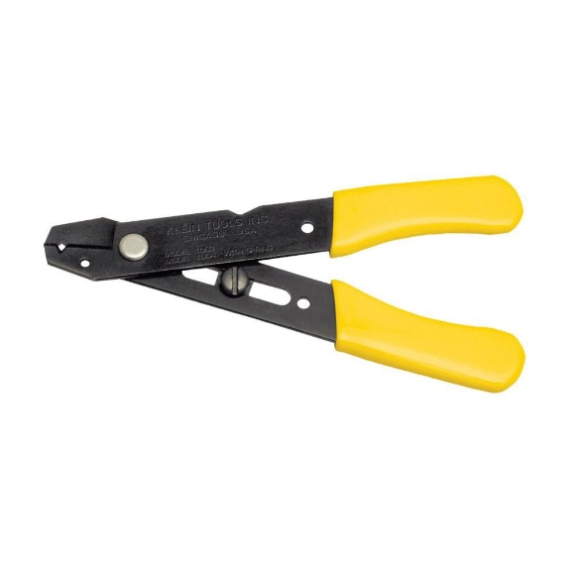
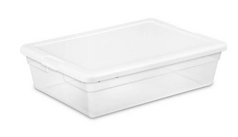
Tools and box
A significant portion of course content is experience in electrical assembly
Take appropriate care to avoid damaging components
Will sell you replacement parts from a cache of spares

Slide 20
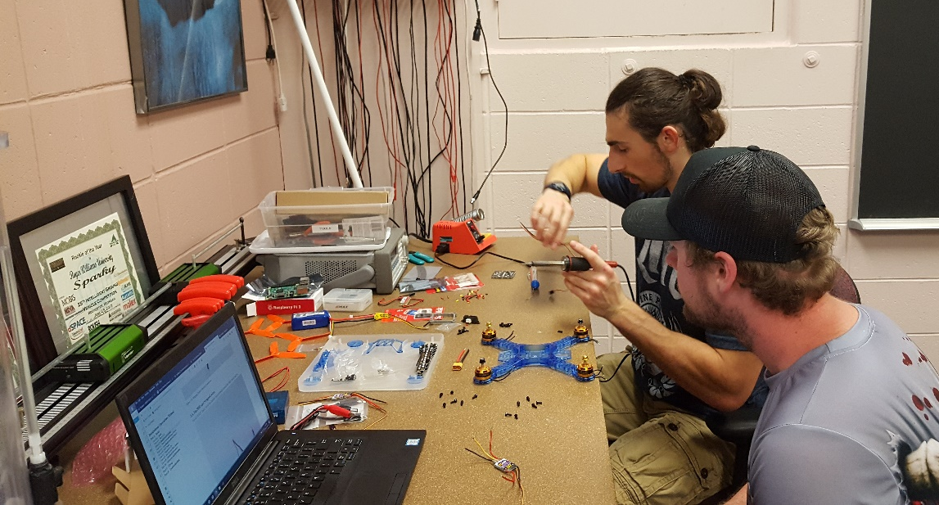
Completed drone looks something like this
About 3 weeks to assemble
Dedicated class time for assembly, but will probably require more than in-class time
Volunteers required about 12 hours assembly time last year

